Slide 1
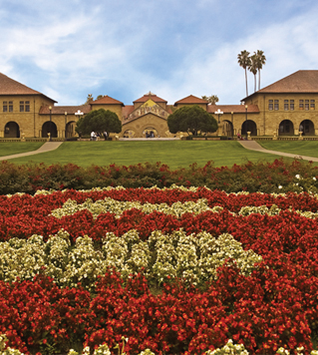
Genes as IVs and Epigenetics 2016 Summer Workshop CEDUA El Colegio de Mexico, A. C.
Ben Domingue

Slide 2
Goals
MR
Review
Brief overview of other ideas

Slide 3
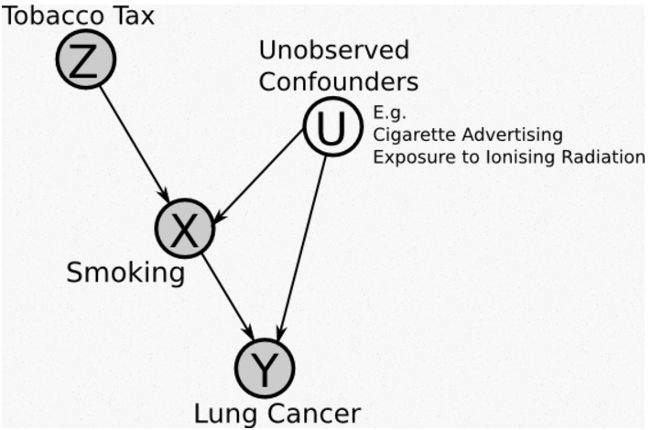
Mendelian Randomization
Basic idea: genes as instrumental variables
http://jamesmcm.github.io/blog/2014/08/17/mendelian/

Slide 4
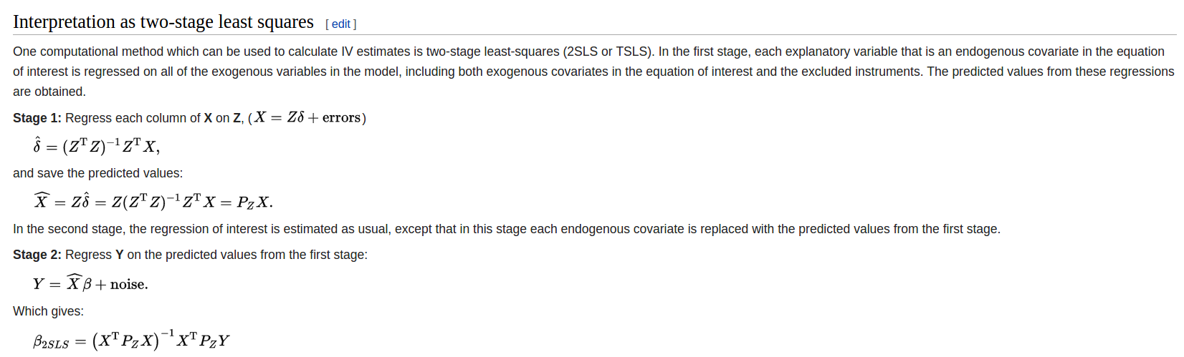

Slide 5
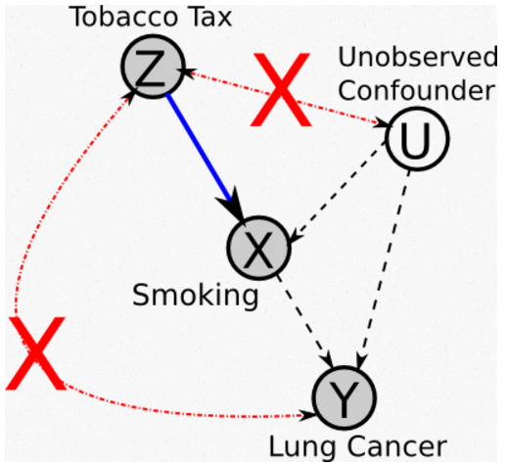
Assumptions
Z → X (not X → Z)
No Z→Y
Z not associated with U

Slide 6
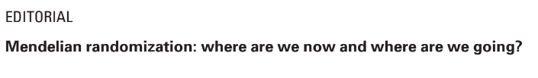
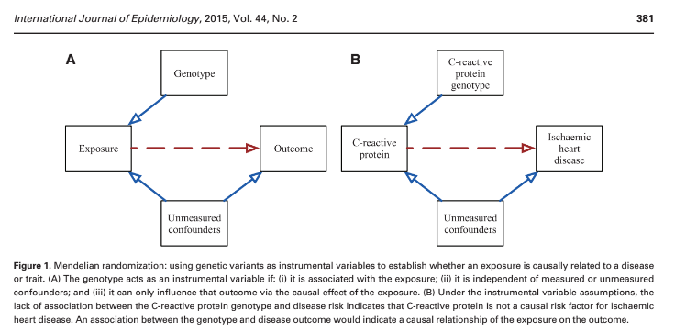
What are biological assumptions?

Slide 7
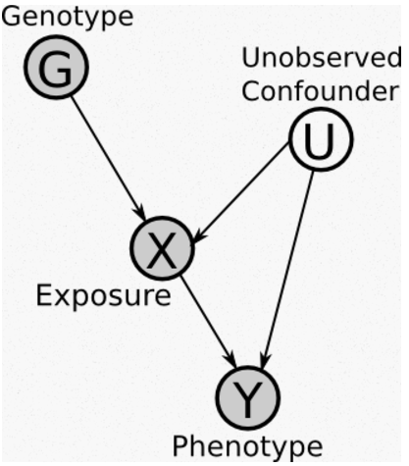
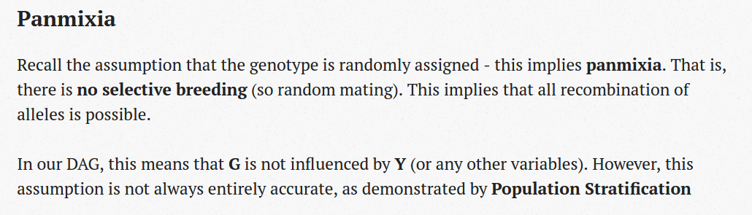

Slide 8
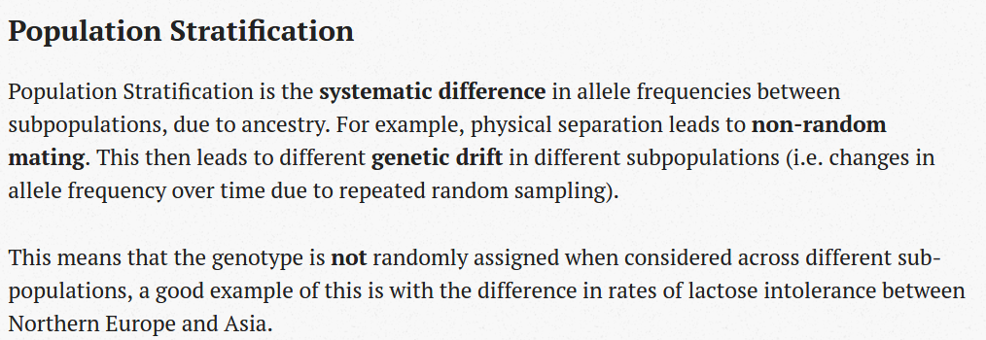

Slide 9
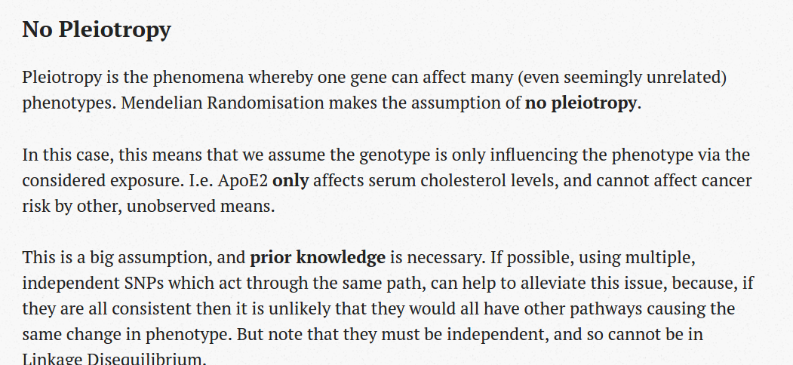

Slide 10
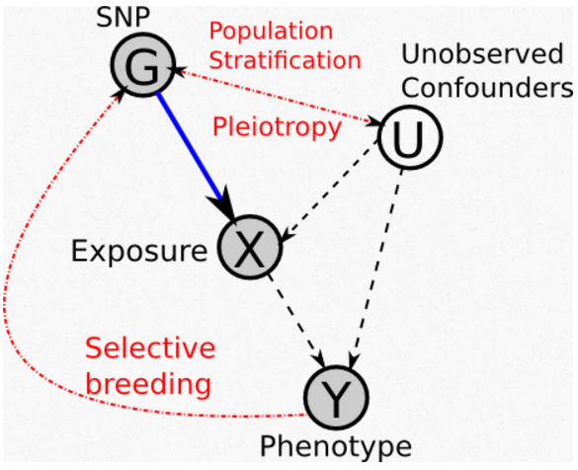

Slide 11
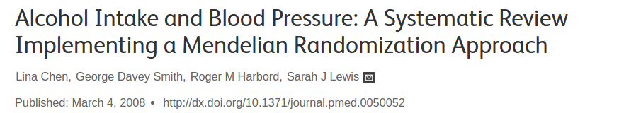
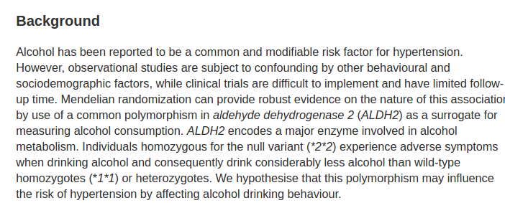

Slide 12
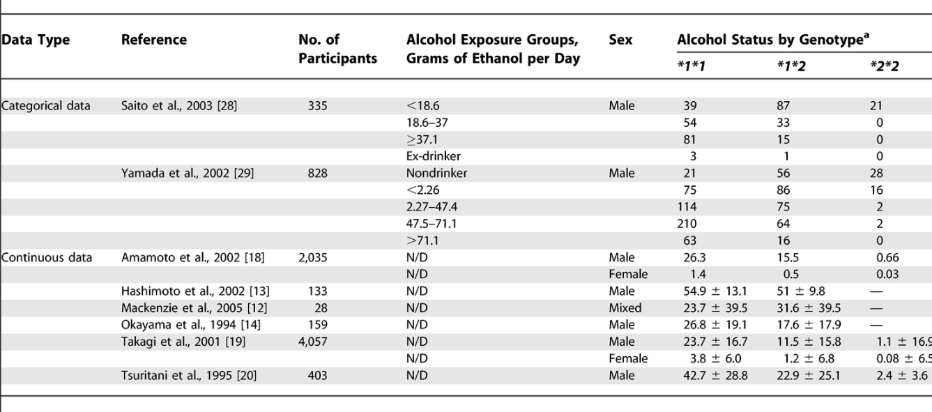

Slide 13
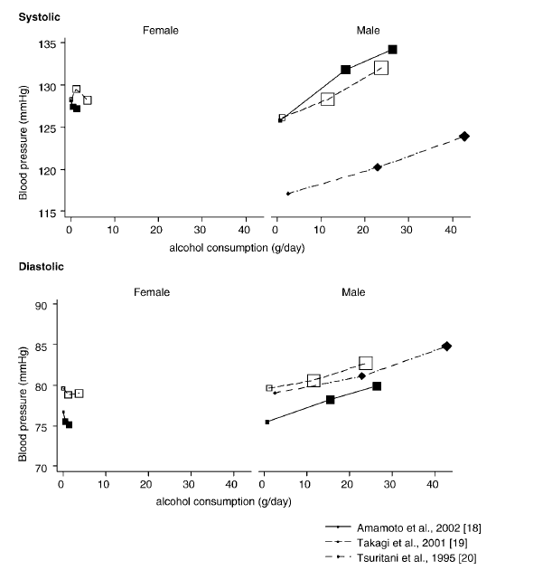

Slide 14
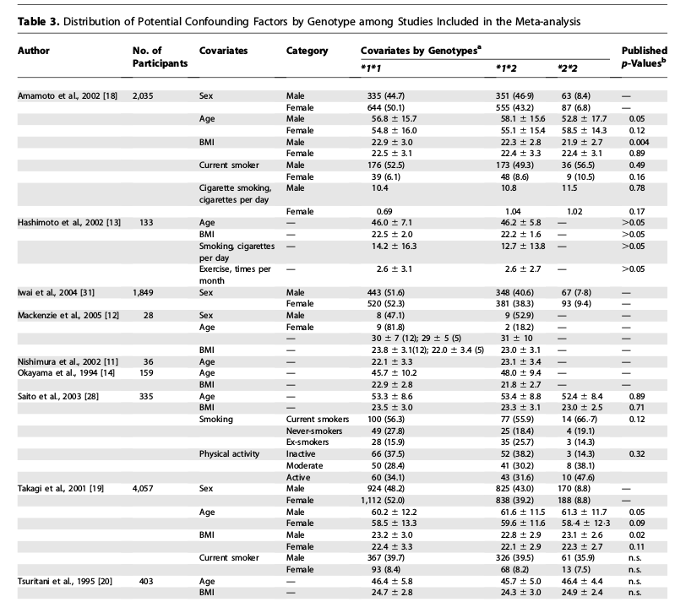

Slide 15
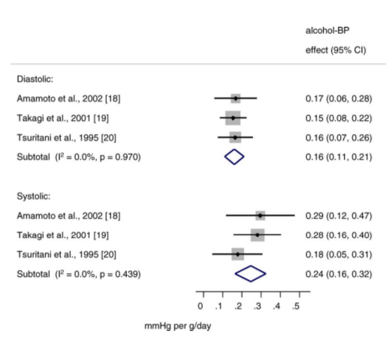
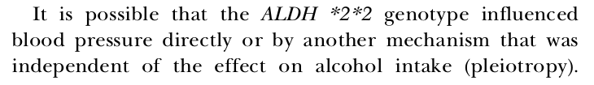
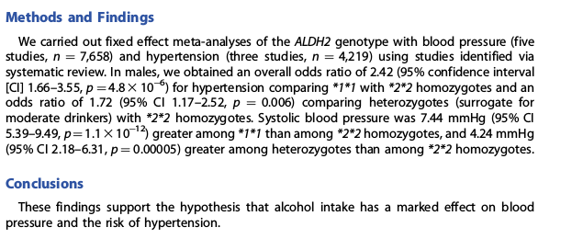

Slide 16
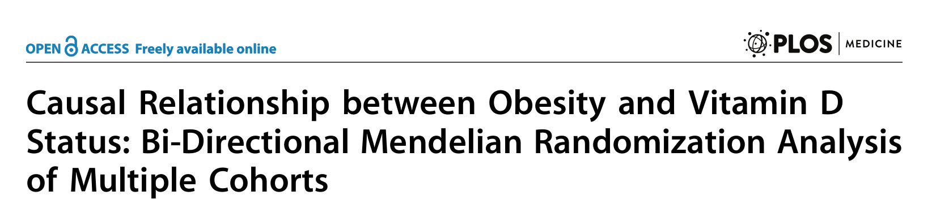
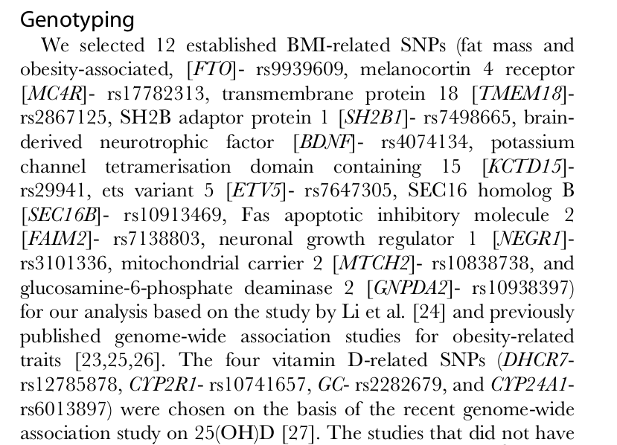
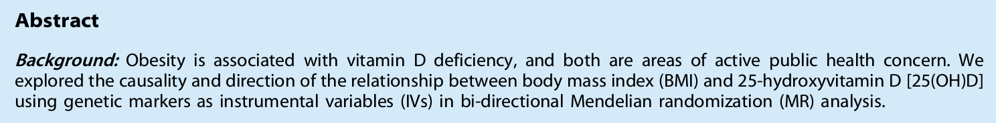

Slide 17
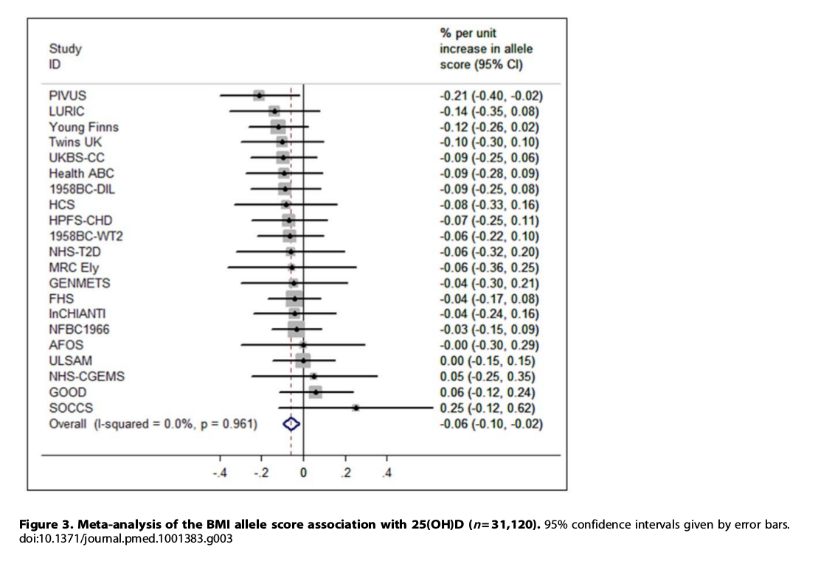

Slide 18
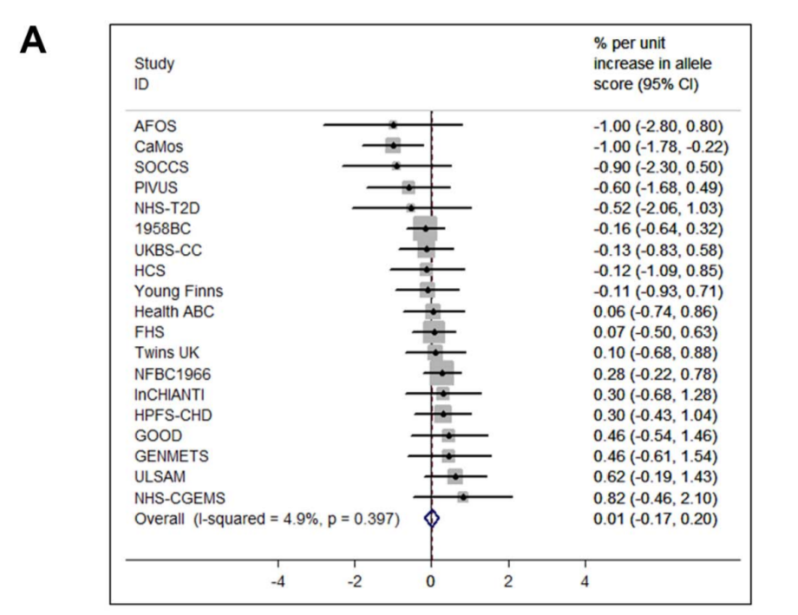

Slide 19
Your turn!

Slide 20
Review from this week

Slide 21
Turkheimer’s Law of BG
First Law: All human behavioural traits are heritable.
Second Law: The effect of being raised in the same family is smaller than the effect of the genes.
Third Law: A substantial portion of the variation in complex human behavioural traits is not accounted for by the effects of genes or families.

Slide 22
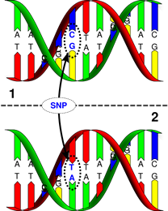
Single Nucleotide Polymorphisms (SNPs)
SNPs occur ~1/300 base pairs
In >1% of the population.

Slide 23
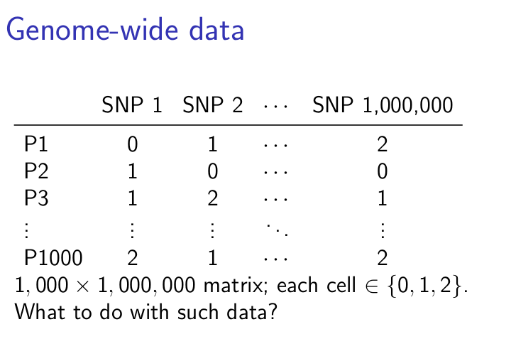

Slide 24
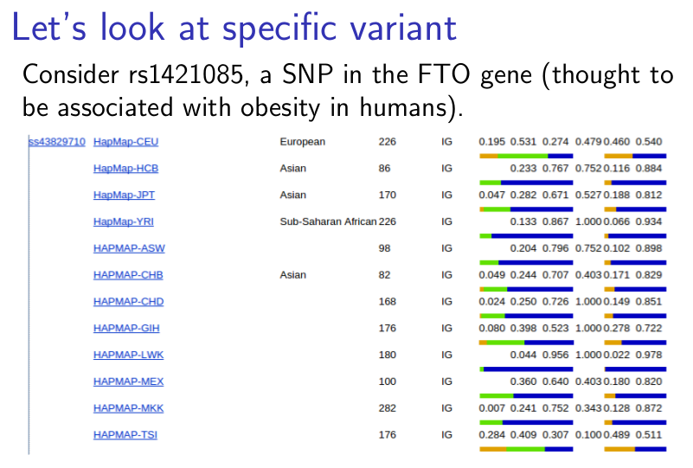
NOTE: Allele frequencies are not constant across human populations (“population stratification”)

Slide 25
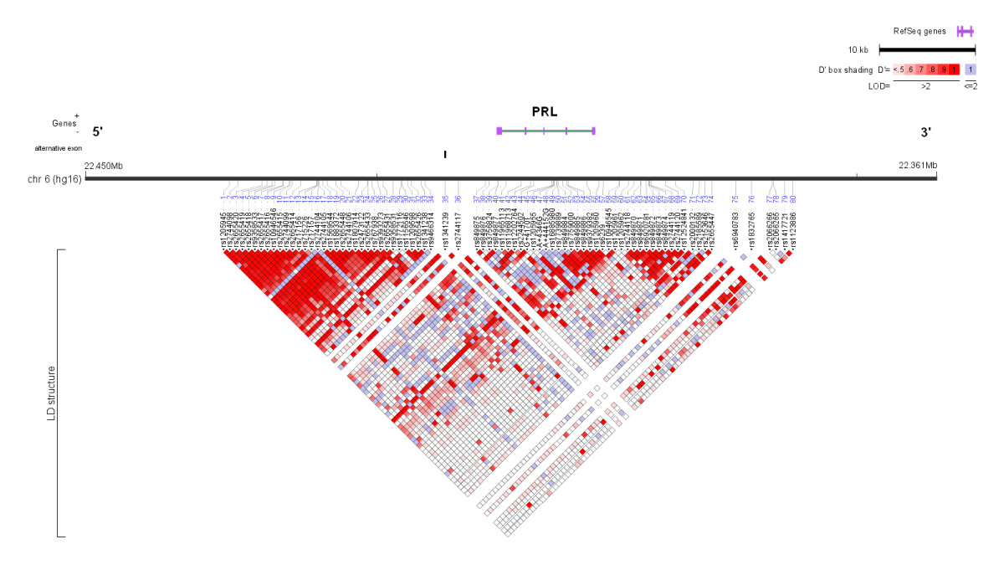
Linkage map
Tag SNPs
Linkage patterns vary across population.
Tag SNP in one group may not tag same gene in different population.

Slide 26
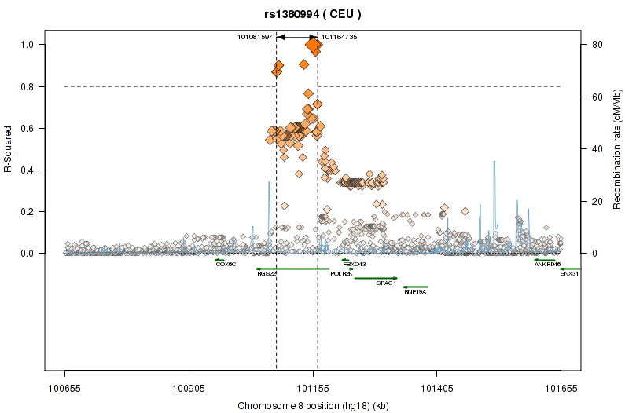
Tag SNPs

Slide 27
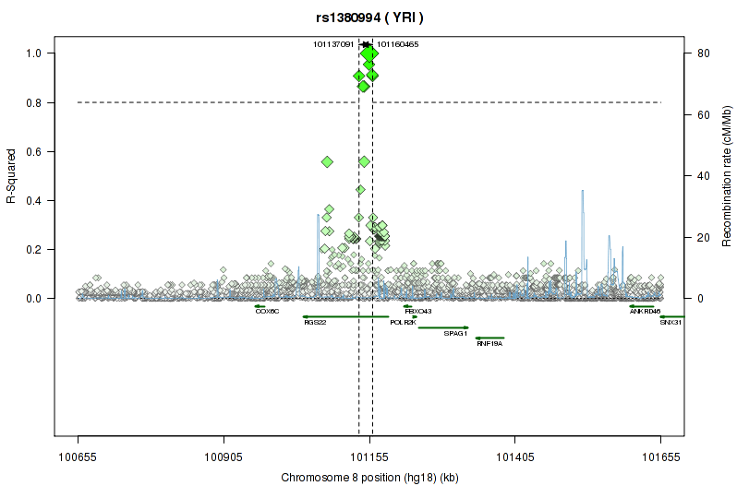
Tag SNPs

Slide 28
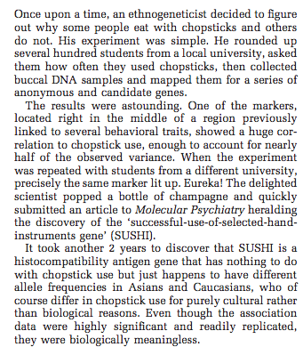
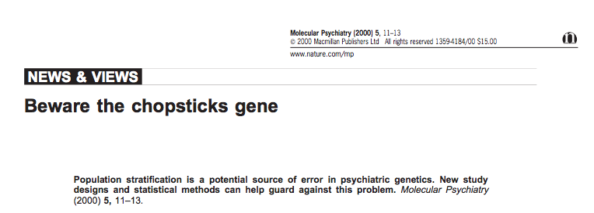
Chopsticks gene

Slide 29
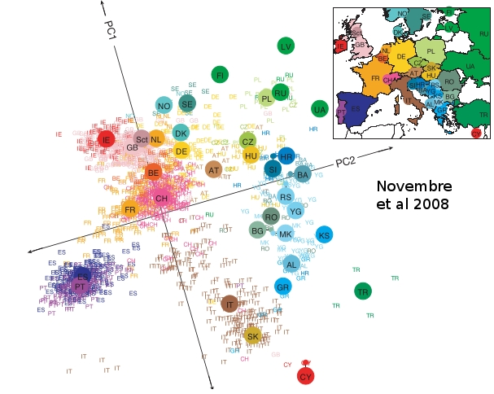

Slide 30
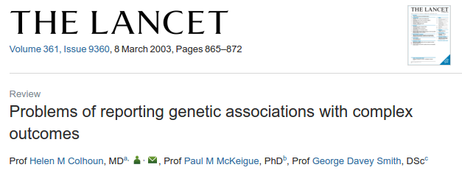
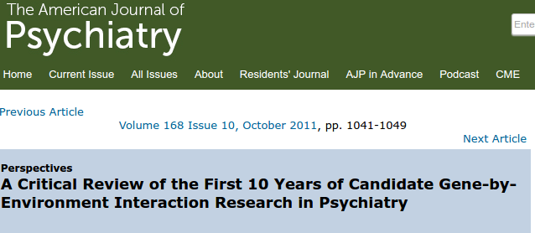
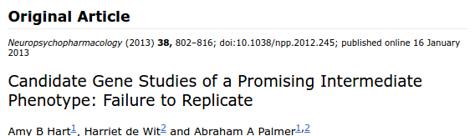
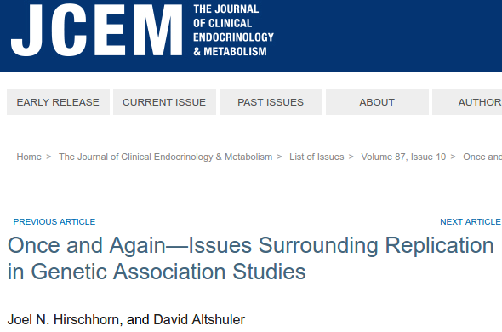
How do we link phenotypic variation to genetic variation?
First idea: candidate genes
A priori biological reason to suspect relevance.

Slide 31
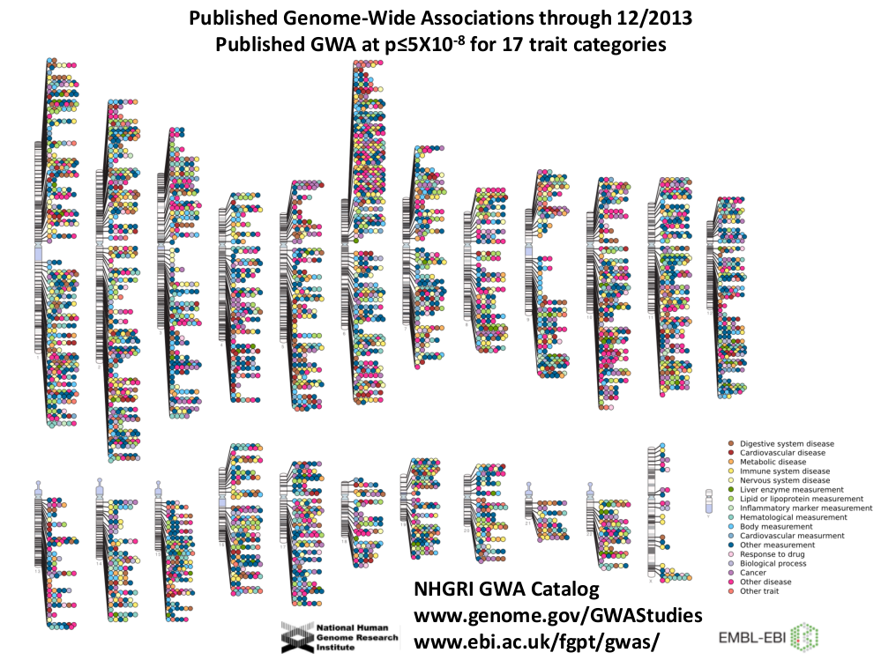

Slide 32
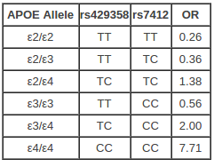
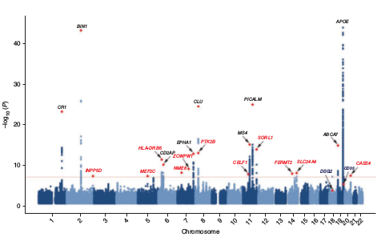
Alzheimer’s
Baseline risk:
9% M, 17% F
Source:
Genomes Unzipped
Lambert et al. 2013

Slide 33
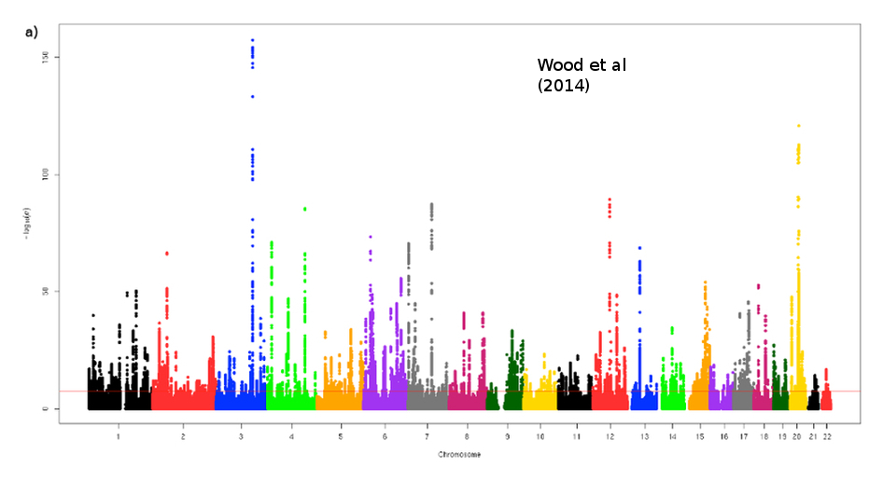
Height

Slide 34
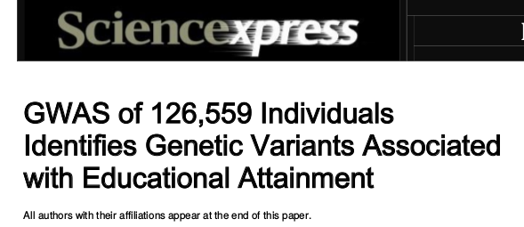
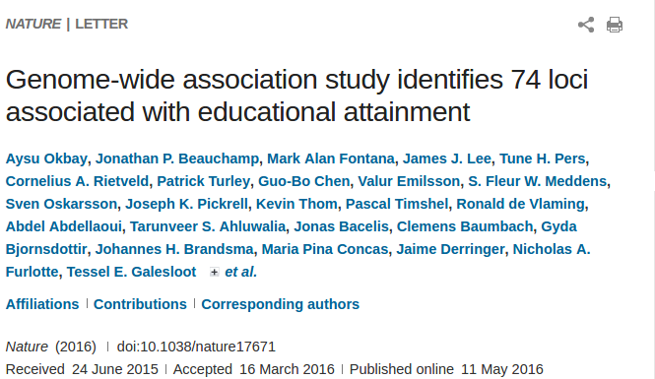
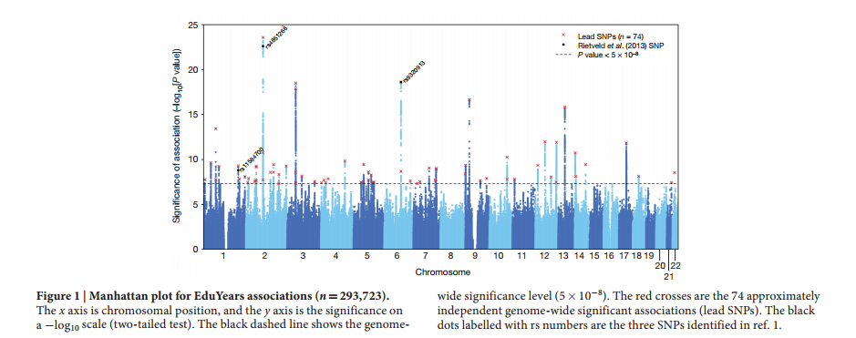
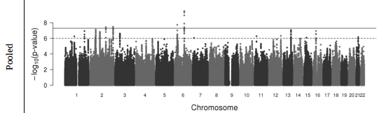
NEW!

Slide 35
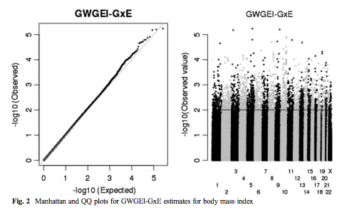
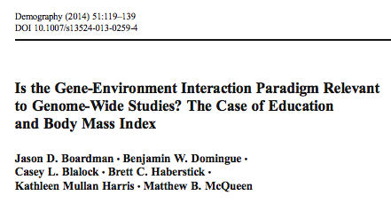
Why you shouldn’t do a gwas

Slide 36
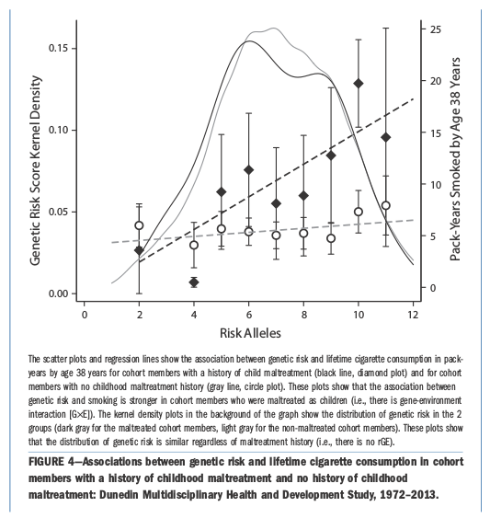
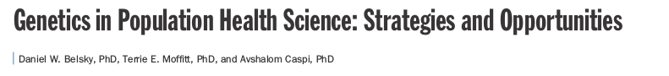

Slide 37
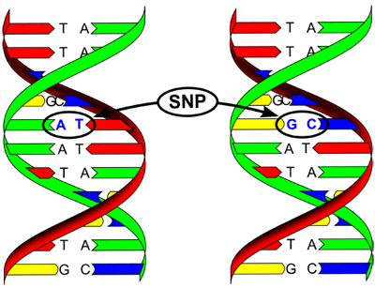
Ambiguous strands

Slide 38

Robust prediction, now what?
Possibilities
Developmental pathways & broader outcomes
Association and moderation by schools
Dynamics (as function of birth cohort)
And nothing is necessarily constant over time!

Slide 39



Slide 40



Slide 41


Slide 42





Slide 43
Mendelian Randomization
Possible use for top-hits genome-wide score?
Used to adjust observational association estimates for confounding.

Slide 44


Slide 45


Slide 46



Very widely used!!!

Slide 47
What else might you want to study?

Slide 48

Other types of genetic variation
Copy number variants, microsatellites
Rare variants

Slide 49

Higher-order processes
Obviously, lots of things occur between the fixed DNA and our dynamic selves.
Nascent interest in social science/demography in certain of these processes.
I’m going to talk about those that are fairly close to the genetics.

Slide 50


Epigenetics: what is it?

Slide 51


Why do we care?

Slide 52


Dutch Hunger Winter

Slide 53
Examples
Two epigenetic processes
Telomeres
methylation

Slide 54

Telomeres
These shorten with age.

Slide 55



Slide 56

Methylation

Slide 57



Slide 58


Slide 59



Slide 60



Slide 61
bdomingue@Stanford.edu
Please let me know if you have any advice/comments/critiques of the course. I’m all ears.
Thanks!

